Slide 1
Data Stucture and Algorithms
Dr. Fidaa Abed

Slide 2
Data Structures
Stack
Queue
Piriority Queue
Deque

Slide 3
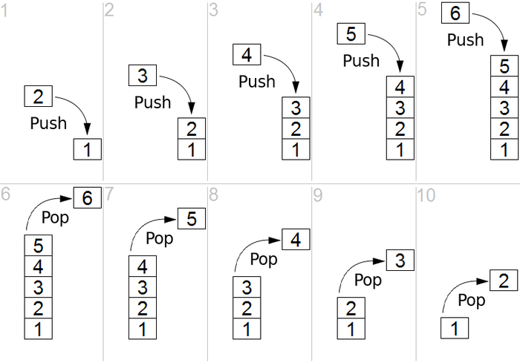
Stack
Last In First Out (LIFO)
Operations: push(x), pop()
add(x), remove()
Application: reverse a word

Slide 4
Example

Slide 5
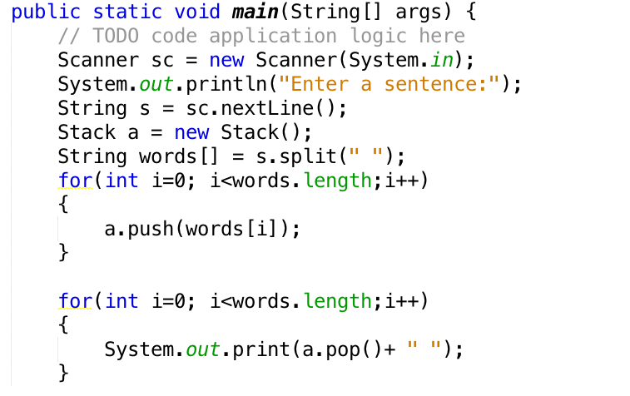

Slide 6
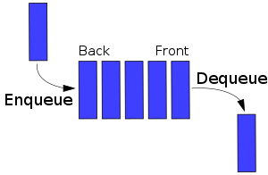
Queue
First In First Out (FIFO)
Operations: enque(x), deque()
add(x), remove()
Application: CPU schedule

Slide 7
Example

Slide 8
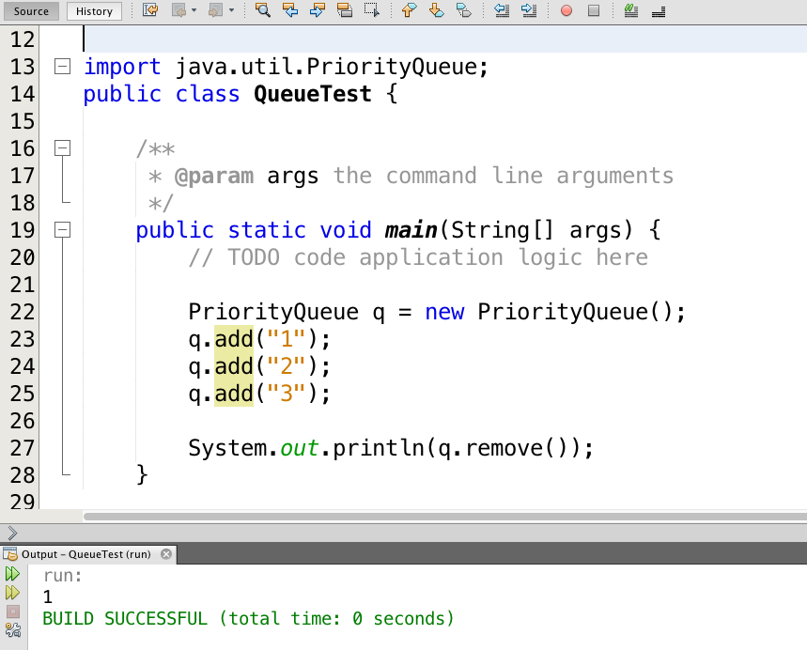

Slide 9
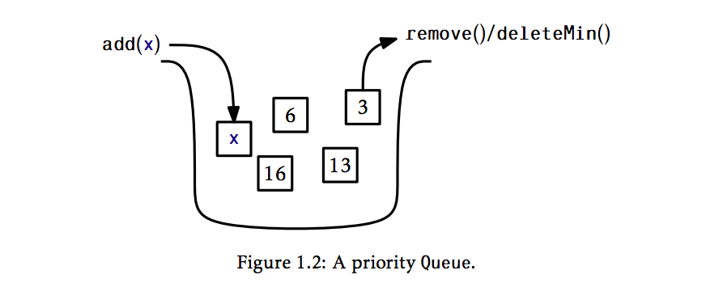
Piriority Queue
Highest Piriority First
Operations: enque(x), deletmin()
add(x), remove()
Application: Emergency Room

Slide 10
Example

Slide 11
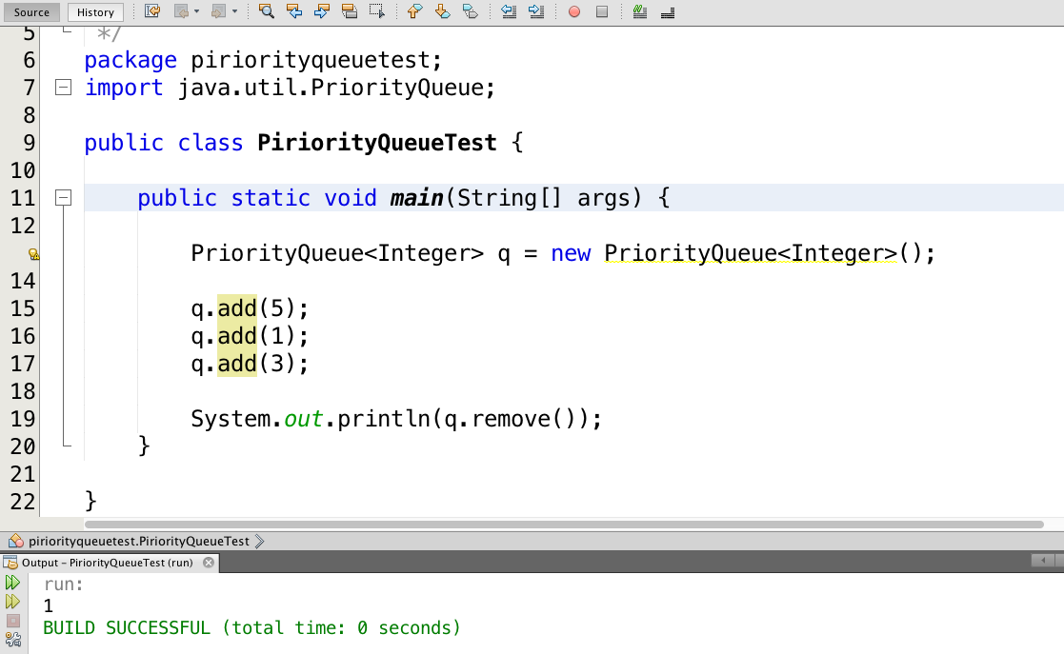

Slide 12

Deque
Double-ended queue
Stack+Queue
Operations:
addFirst(x), addLast(), removeFirst(), removeLast()
Stack:
addFirst(x) + removeFirst()
Queue:
addFirst(x) + removeLast()

Slide 13
Example

Slide 14
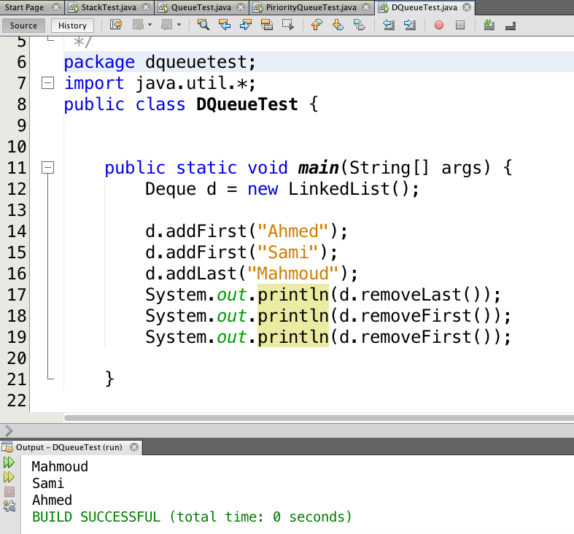

Slide 15
Exercises

Slide 16
Solve the following problems by reading a text file one line at a time and performing operations on each line in the appropriate data structure(s).
Your implementations should be fast enough that even files containing a million lines can be processed in a few seconds.

Slide 17
Read the input one line at a time and then write the lines out in reverse order, so that the last input line is printed first, then the second last input line, and so on.

Slide 18
2. Read the first 50 lines of input and then write them out in reverse order. Read the next 50 lines and then write them out in reverse 26 order. Do this until there are no more lines left to read, at which point any remaining lines should be output in reverse order.
In other words, your output will start with the 50th line, then the 49th, then the 48th, and so on down to the first line. This will be followed by the 100th line, followed by the 99th, and so on down to the 51st line. And so on. Your code should never have to store more than 50 lines at any given time.

Slide 19
3. Read the input one line at a time. At any point after reading the first 42 lines, if some line is blank (i.e., a string of length 0), then output the line that occurred 42 lines prior to that one. For example, if Line 242 is blank, then your program should output line 200. This program should be implemented so that it never stores more than 43 lines of the input at any given time.

